Slide 1
Scheme Intro
Leeds Code Dojo

Slide 2
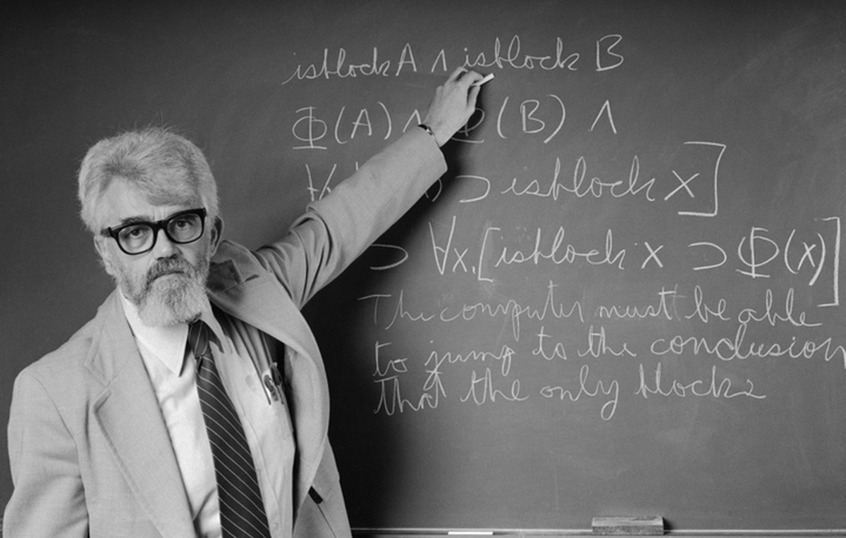
A Brief History of Scheme
1958: John McCarthy invents Lisp (LISt Processor) at MIT as a way of (manually) studying computing
It’s all about the math

Slide 3
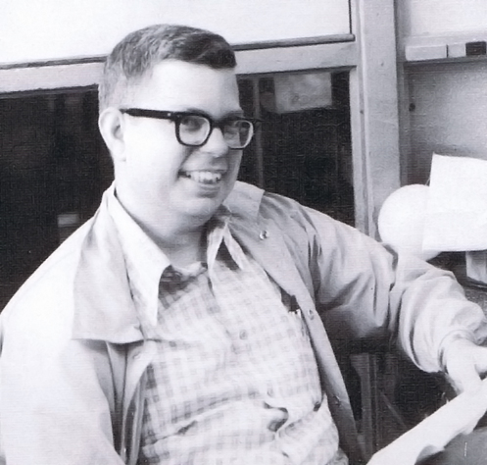
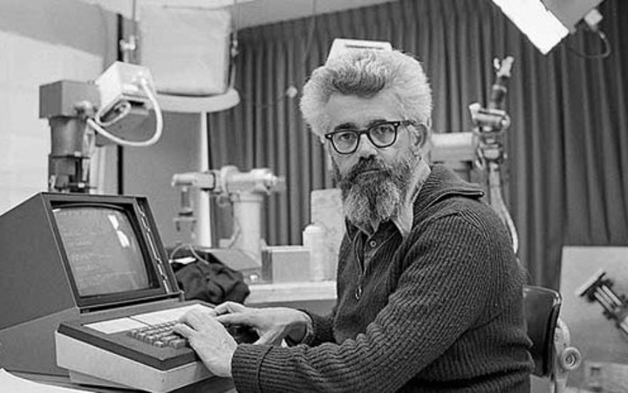
A Brief History of Scheme
1958: Steve Russel implements eval function in machine code, resulting in a Lisp interpreter
Lose the chalk, bro! I made Lisp on your MacBook.
Sweet

Slide 4
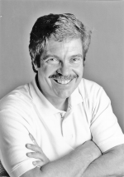
Random Quote #1
“..the greatest single programming language ever designed." - Alan Kay, on Lisp

Slide 5

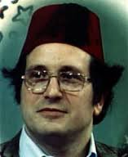
A Brief History of Scheme
1975: Guy Steel & Gerald Sussman at MIT create Lisp-based language Schemer to study the newly-proposed actor model
Schemer turns out to be a good language in its own right – unfortunately their OS only allowed 6 characters, so Scheme is born!
Schemer

Slide 6
Family Tree: Lisps
Lisp
Fully-featured, multi-paradigm
Common Lisp
Scheme
Minimal, mainly functional
Other Stuff

Slide 7
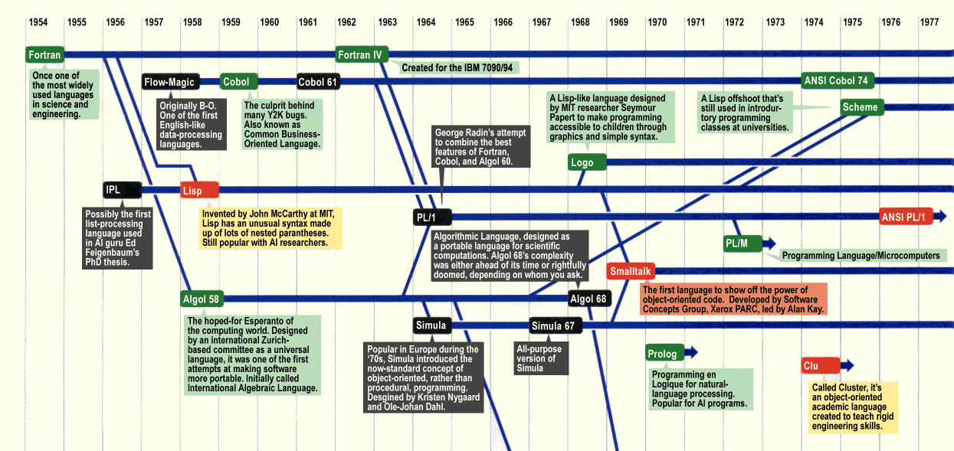
Family Tree: General

Slide 8
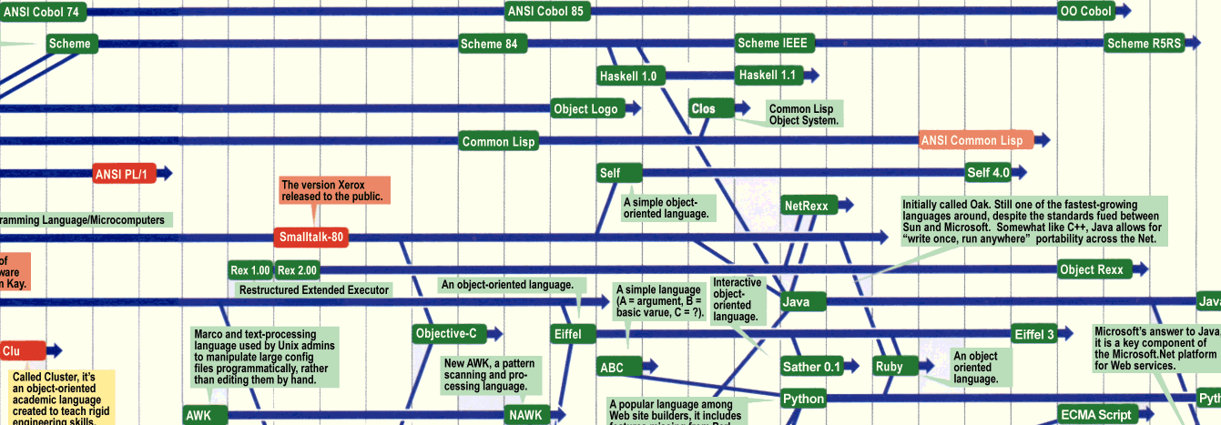
Family Tree: General
Clojure
Racket

Slide 9
Scheme Sample
(define (fizz number)
(define (divisible-by? dividend)
(eq? (modulo number dividend) 0))
(cond
((divisible-by? 15) "FizzBuzz")
((divisible-by? 5) "Buzz")
((divisible-by? 3) "Fizz")
(else (number->string number))))
> (fizz 15)
“FizzBuzz”

Slide 10
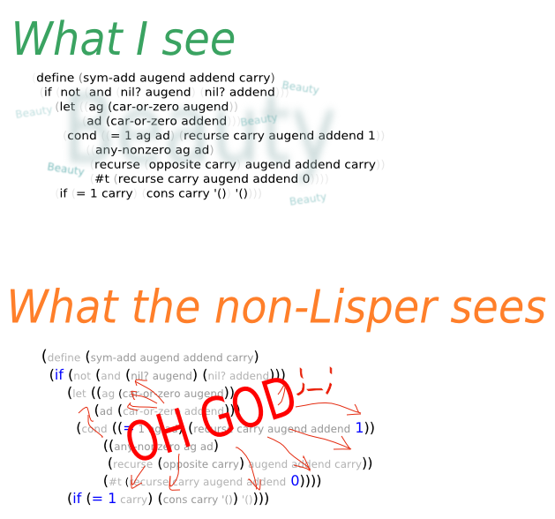
Parentheses

Slide 11
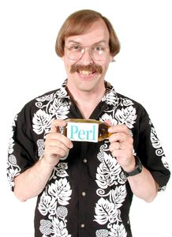
Random Quote #2
"Lisp has all the visual appeal of oatmeal with fingernail clippings mixed in." - Larry Wall, creator of Perl(!)

Slide 12
Language Basics
Functional
First-class functions
Expression based
Not immutable
Dynamically typed
Large type system (especially numbers)
Enforced at run time
Homoiconic
Heavy use of recursion & continuations
Tail call optimisation guaranteed

Slide 13
Atoms, Lists & Homoiconicity
Atoms
1
“Hello”
Lists
‘(1 “Hello” #t)
‘(“hi” (1 2 3) mum 0.5))
Scheme Programs
(+ 1 2)
(if (eq? 1 2) “hello” 1)
Small but important..

Slide 14
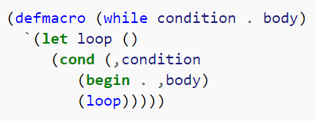
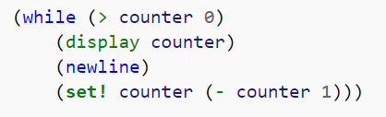
Macros
Allow you to define new language constructs and modify code without restriction

Slide 15

Random Quote #3
"Lisp isn't a language, it's a building material." - Alan Kay

Slide 16
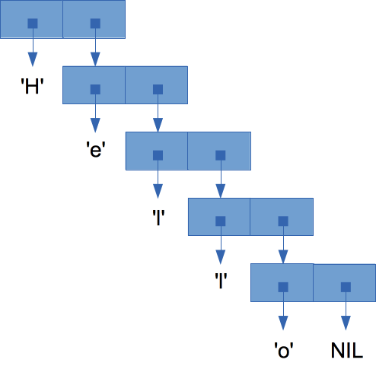
Lists – Recursive
Scheme lists are a recursive data structure
(H e l l o):
Actual form: (H (e (l (l (o ‘())))))
Empty list

Slide 17
Lists – Functions
car gets head of list (which is a single item)
cdr gets tail of list (which is a list)
cons builds lists by appending an item to a list
(cons h ‘(e l l o)) ➔ ‘(h e l l o)
car
cdr

Slide 18
Recursion
Recursion is the typical way to work with lists.
(define (contains? item a-list)
(cond
((null? a-list) #f)
((eqv? (car a-list) item) #t)
(else (contains? item (cdr a-list)))))
(contains? 4 ‘(1 2 3)) ➔ #f
Learn to love it..

Slide 19
Why?
Still popular – Clojure, Racket, etc.
Good learning language
Implement your own interpreter!
See Random Quote #4

Slide 20

Random Quote #4
"Lisp is worth learning for the profound enlightenment experience you will have when you finally get it; that experience will make you a better programmer for the rest of your days, even if you never actually use Lisp" - Eric Raymond, "How to Become a Hacker"

